Slide 1



Analyzing Revenue and Profitability for
Strategic Growth
Olumide Balogun +234-8065060691

Slide 2
Executive Summary
Objectives of the Project
Tasks / Questions : A Detailed Examination of Diagnostic, Predictive, and Prescriptive Analytics
Tools Used throughout the Project
Approach, Analysis, and Technical Challenges
Key Findings: Objective, Purpose, and Results (Hypotheses, Insights, and Interpretations from Visualizations and Models)
Final Recommendations
Contents
Olumide Balogun +234-8065060691
1

Slide 3
Executive Summary
The company conducted a comprehensive analysis of its revenue and profitability from 2020 to 2023, leveraging advanced diagnostic, predictive, and prescriptive analytics to uncover trends, address disparities, and identify growth opportunities. Transitioning from its startup phase, the company achieved significant market presence, marked by exceptional growth in 2021, a decline in 2022 due to challenges, and a strong recovery in 2023 driven by strategic adjustments. This analysis provides actionable insights to optimize costs, enhance product profitability, expand market reach, and strengthen customer engagement, laying the foundation for sustainable growth, long-term profitability, and a stronger competitive edge.
Key Insights
Revenue Trends and Growth Opportunities:
2021 marked a period of exceptional growth due to market reach expansion and robust marketing strategies.
A notable decline in 2022 was attributed to external and internal challenges, including competition and operational inefficiencies.
Recovery in 2023 highlights the effectiveness of corrective strategies such as product quality improvements and market retargeting.
Market Zone Analysis
Top Performers: North-Central zone leads with $25.12M revenue and $0.43M profit.
Underperformers: North-East and South-South zones show significant revenue and profitability gaps, demanding tailored interventions.
Olumide Balogun +234-8065060691
2

Slide 4
Product Performance
"Own Brand" dominates revenue ($23.4M), though with lower profit margins.
"Wholesale Goods" shows the highest profitability despite lower sales volumes.
Customer Segment Insights
Brick and Mortar: Top performer with $32.76M revenue and $0.56M profit.
E-Commerce: Higher profit margins but lower total revenue, suggesting untapped potential.
Critical Relationships
Strong correlation between revenue and cost price (0.99) highlights the need for cost efficiency.
Volume impacts revenue positively (0.58), but its relationship with profitability remains negligible, underscoring the need for better margin management.
Forecasts and Future Trends
Revenue stabilization expected by 2025, requiring targeted interventions to avoid stagnation.
Seasonal trends indicate predictable peaks and troughs, which can be leveraged for inventory and resource planning.
Strategic Recommendations
Market and Segment Optimization: Focus on high-performing zones like North-Central and address underperforming areas with tailored strategies. Prioritize high-margin products such as "Wholesale Goods" while refining pricing for "Own Brand" and "Third-Party Brand" products.
Olumide Balogun +234-8065060691
3

Slide 5
2. Customer-Centric Strategies: Enhance engagement with top-revenue customers through personalized loyalty programs and exclusive offers. Employ cost-effective marketing to boost contributions from moderate and low-value customer segments.
3. Operational and Cost Efficiencies: Optimize costs through supplier renegotiations, cost-benefit analyses, and streamlined supply chain operations. Use predictive analytics to manage inventory effectively and reduce waste.
4. Growth and Innovation: Expand offerings and enter underserved markets to drive revenue growth. Utilize digital marketing and e-commerce platforms to increase sales volumes and customer reach.
5. Profitability through Pricing Strategies: Adjust prices strategically to improve margins while maintaining demand. Strengthen cost controls to safeguard profit margins against rising operational expenses.
Expected Outcomes
Revenue Growth: Achieve 15–20% annual growth through enhanced market presence and customer-centric strategies.
Profit Margins: Improve by 10–12% through cost efficiencies and optimized pricing.
Customer Retention: Increase by 20–30% via tailored loyalty initiatives and targeted engagement.
Market Share: Realize a 5–8% rise in key zones through strategic campaigns.
Operational Efficiency: Enhance by 15–20% through process optimization and technology integration.
Olumide Balogun +234-8065060691
4

Slide 6
Objectives of this Project
This project aimed to leverage advanced analytics to empower the company's strategic decision-making processes. Key objectives included:
Performance Diagnosis: Analyze trends in revenue, profitability, and volume from 2020 to 2023 to identify growth patterns and operational challenges.
Customer and Product Analysis: Evaluate revenue and profit contributions across customer segments and product categories, focusing on high-value segments and optimizing product strategies.
Market Zone Evaluation: Assess market zone performance to identify high-performing regions and areas for growth through targeted interventions.
Revenue and Profitability Drivers: Analyze key variables like cost price, volume, and pricing to uncover opportunities for cost management and profitability optimization.
Future Forecasting: Use predictive analytics to forecast revenue trends and seasonal patterns, enabling better planning and resource allocation.
Strategic Recommendations: Deliver actionable strategies for market expansion, customer engagement, product optimization, and long-term sustainability.
The project provided data-driven insights to support sustainable growth, operational efficiency, and profitability.
Olumide Balogun +234-8065060691
5

Slide 7
Tasks / Questions : A Detailed Examination of Diagnostic, Predictive, and Prescriptive Analytics
1. Did any years experience negative or stagnant growth?. Furthermore, are there significant differences in the data?
2. Which customer types, product types, and market zones rank among the top 20 with total revenue surpassing $4.00 million?
3. Which customer types, product types, and market zones rank among the top 20 with total profits exceeding $0.06 million?
4. Is there a clear upward or downward trend in performance over time?
5. How do revenue and profitability differ across various market zones?
6. How do revenue and profit vary across different product types?
7. How do revenue and profit vary across different customer types?
8. To display the correlation matrix and perform statistical correlation analysis with significance testing using the psych package.
9. How Does Volume Directly Impact Revenue Growth?
10. How Does Volume Drive Profitability?
11. How Does Revenue Influence Profitability?
12. How Does Cost Price Influence Revenue Streams?
13. What Role Does Cost Price Play in Driving Profitability?
14. What Role Does Cost Price Play in Driving Volume Sold?
15. What Key Drivers Contribute to Revenue Performance?
16. What are the seasonal patterns and long-term trends in revenue over time?
17. What are the predicted revenue trends for the next 36 months, and how can these insights be leveraged to drive favorable business decisions?
18. How do average selling price, profit margin, and price elasticity impact revenue and business strategies?
19. Which customers contribute to the majority (80%) of the business's total revenue?
20. Which customer segments, based on clustering, contribute the most to overall revenue and sales volume?
Olumide Balogun +234-8065060691
6

Slide 8
Tools Used throughout the Project
For my deep dive into the company's sales outlook, I utilized the following tools and technologies:
R: The backbone of my analysis, empowering me to clean and format data, conduct advanced analyses and modeling, create visualizations, and uncover critical insights. I relied on libraries such as dplyr, ggplot2, readr, lubridate, forecast, randomForest, psych, …
PowerPoint: Essential for presenting complex findings, insights, and recommendations in a visually engaging and easily understandable way for stakeholders and decision-makers.
Git & GitHub: Vital for version control, sharing R scripts, and facilitating seamless collaboration and project tracking throughout the analysis process.
Olumide Balogun +234-8065060691
7

Slide 9
Approach, Analysis and Technical Challenges
Data Collection:
Obtained data tables from the management team for analysis.
Data Preparation:
Compiled, formatted, cleaned, and transformed the raw data into a unified and consistent dataset.
Addressed missing values, removed duplicates, and handled outliers to improve data reliability.
Corrected spelling errors and adjusted data types to ensure accuracy and consistency.
Data Enhancement:
Created calculated variables to support deeper and more meaningful analysis.
Exploratory Data Analysis (EDA):
Conducted detailed exploratory analysis using graphical visualizations and statistical techniques to uncover trends, patterns, and relationships within the data.
Advanced Analysis and Modeling:
Leveraged machine learning models and visual plots to identify key drivers of performance and derive actionable insights.
This structured approach enhances data clarity and reliability, effectively addressing technical challenges and delivering actionable insights to support informed decision-making.
Olumide Balogun +234-8065060691
8

Slide 10
Key Findings: Objective, Purpose, and Results (Hypotheses, Insights, and Interpretations from Visualizations and Models)
Olumide Balogun +234-8065060691
9

Slide 11
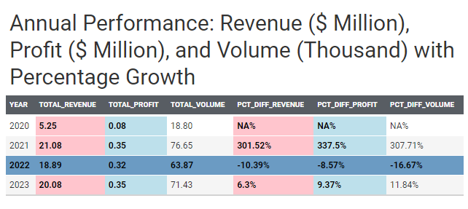
1. Annual Revenue, Profit, and Volume Performance with Percentage Growth.
Task / Question : Did any years experience negative or stagnant growth?. Furthermore, are there significant differences in the data?
Purpose: To identify trends over time and detect periods of underperformance or stagnation, as well as to assess whether variations in key metrics(e.g., revenue, profit, Volume ) are statistically or practically significant. This helps pinpoint problem areas that may require further investigation or corrective action.
Insights:
2020: This year serves as the baseline. The relatively low numbers indicate a startup phase (possibly in the 4th quarter of 2020), a small customer base, and limited product availability.
2021: Exceptional growth occurred this year, indicating effective scaling driven by increased demand, improved market reach, and successful marketing or distribution strategies.
2022: A decline in performance is noted, possibly due to challenges such as increased competition, supply chain issues, or reduced demand.
2023: Recovery is evident, suggesting successful adjustments. The business likely implemented corrective actions such as optimizing operations, improving product quality, or re-targeting its market.
Olumide Balogun +234-8065060691
10

Slide 12
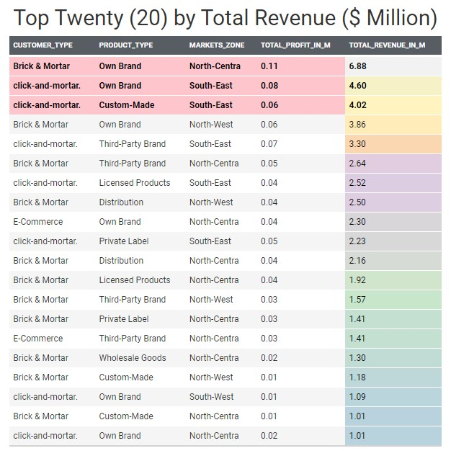
2. Analyzing Top 20 Performers by Customer Type, Product Type, and Market Zone: Revenue and Profitability Analysis.
Task / Question : Which customer types, product types, and market zones rank among the top 20 with total revenue surpassing $4.00 million?
Purpose: To identify the highest-performing customer type, product type, and market zones based on total revenue, enabling businesses to prioritize resources and optimize strategies for growth. This analysis helps uncover key success factors and target areas for expansion.
Insights:
Brick & Mortar: Leads with $6.88M in revenue from the product type "Own Brand" in North-Central. This showcases dominance in physical retail, driven by strong in-person shopping demand, robust brand loyalty, and customer trust, while also reflecting strong consumer demand and efficient operations.
Click-and-Mortar: Generates $4.60M from "Own Brand" and $4.02M from "Custom-Made," both in South-East. This highlights the potential of product diversity and hybrid sales models (integrating online and offline channels) to attract a broad customer base and meet the increasing demand for personalized products.
Olumide Balogun +234-8065060691
11

Slide 13
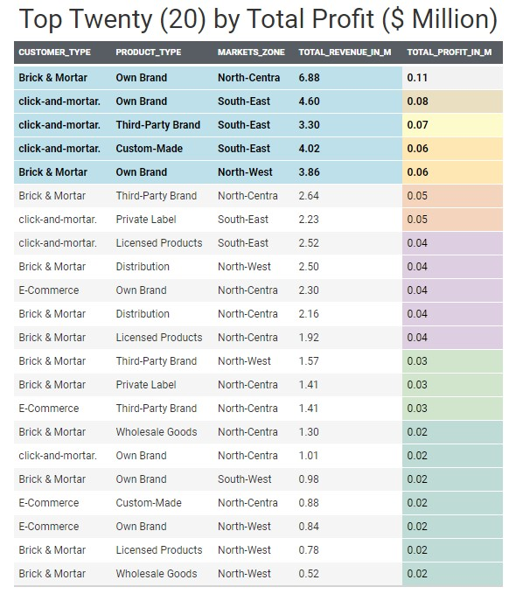
3. Analyzing Top 20 Performers by Customer Type, Product Type, and Market Zone: Profit and Revenue Insights.
Task / Question : Which customer types, product types, and market zones rank among the top 20 with total profits exceeding $0.06 million?
Purpose: To identify profitable , customer types, product types, and market zones that drive significant profit, beyond just sales volume. This analysis helps optimize resource allocation and evaluate the relationship between sales and profitability for sustainable growth.
Insights:
Brick & Mortar: Achieved a total profit of $0.11M from the product type "Own Brand" in North-Central and $0.06M in North-West. This success is driven by strong in-store sales and efficient retail operations.
Click-and-Mortar: Generated a profit of $0.08M from "Own Brand," $0.07M from "Third-Party Brand," and $0.06M from "Custom-Made," all in South-East. Click-and-Mortar excels in the South-East, leveraging a hybrid sales approach that combines physical and online channels effectively.
Olumide Balogun +234-8065060691
12

Slide 14
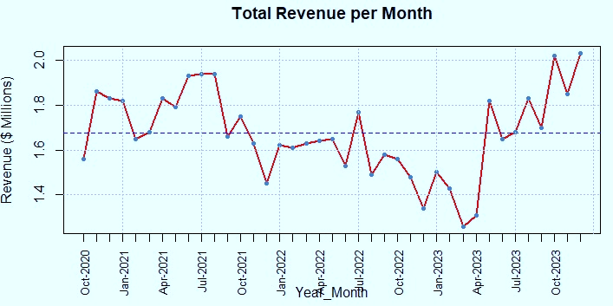
4. Trend Analysis of Revenue Performance Over Time.
Task / Question : Is there a clear upward or downward trend in performance over time?
Purpose: To identify key metrics (revenue) over time to identify long-term trends, assess whether performance is improving or declining, and understand business growth sustainability. This insight helps spot early signs of decline and guide strategic decisions to optimize performance.
Insights:
2022: Consistent declines throughout the year ended with the lowest performance in December (1.34), indicating structural or external challenges. 2023: Showed significant volatility, with March (1.26) as the lowest point but strong recovery in October (2.02) and December (2.03).
Trends:
No sustained upward trend, as peaks occur sporadically without year-on-year consistency.
Clear downward trend from 2021 to 2022, with Q4 showing reduced performance.
Recovery in 2023: Notable improvements started in March, with the strongest growth from March (1.26) to May (1.82), driven by effective strategic adjustments.
Olumide Balogun +234-8065060691
13

Slide 15
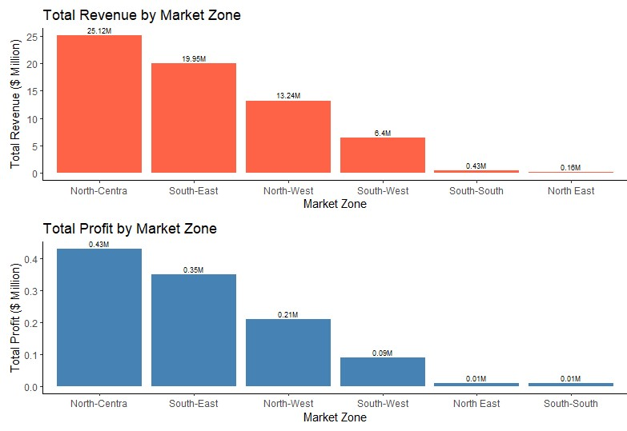
5. Market Zone Performance Analysis.
Task / Question : How do revenue and profitability differ across various market zones?
Purpose: To compare revenue and profitability across market zones, identifying high-performing and underperforming zones. These insights support the optimization of resource allocation, marketing strategies, and sales efforts, ultimately driving business growth and enhancing overall profitability.
Hypothesis: Significant differences in revenue and profitability across market zones highlight varying performance levels, emphasizing the need for tailored strategies to address unique market dynamics and opportunities within each market zone.
Insights:
The North-Central market zone stands out as the top performer, achieving a total revenue of $25.12M and profits of $0.43M, representing 1.71% of its revenue. Following closely is the South-East, with a total revenue of $19.95M and profits of $0.35M, accounting for 1.75% of its revenue.
On the other hand, the North-East records the lowest revenue at $0.16M, while the South-South reports the lowest profit at $0.01M, highlighting significant disparities in market performance across regions.
Olumide Balogun +234-8065060691
14

Slide 16
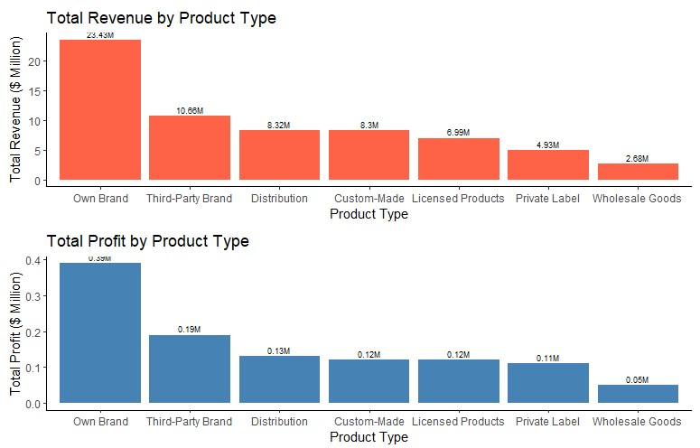
6. Revenue and Profitability Analysis by Product Type.
Task / Question : How do revenue and profit vary across different product types?
Purpose: Is to identify which product types are most profitable and which are underperforming. This insight helps businesses optimize resources, marketing strategies, and inventory management to drive growth and reduce costs.
Hypothesis: Significant differences in revenue and profit across product types indicate that each product performs differently in these areas. From a business perspective, this highlights that customer preferences vary considerably between products.
Insights:
The "Own Brand" product type leads as the top performer, generating a total revenue of $23.4M and profits of $0.39M, which account for 1.67% of its total revenue. Following closely is the "Third-Party Brand" product type, with a total revenue of $10.66M and profits of $0.19M, representing 1.78% of its revenue.
In contrast, "Wholesale Goods" reports the lowest revenue at $4.93M. However, its profits of $0.11M represent an impressive 2.23% of its total revenue, underscoring its high profitability despite relatively low sales figures.
Olumide Balogun +234-8065060691
15

Slide 17
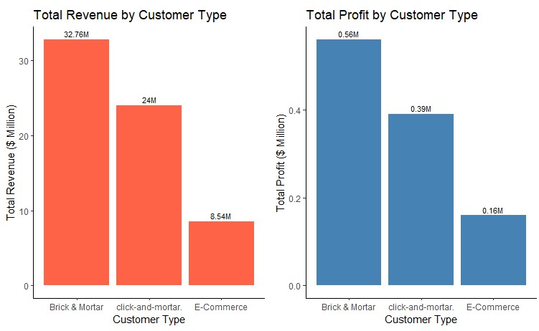
7. Revenue and Profitability Analysis by Customer Types.
Task / Question : How do revenue and profit vary across different product types?
Purpose: To uncover the revenue and profit contributions of different customer types to inform resource allocation, optimize marketing strategies, and drive targeted initiatives for customer retention and revenue growth.
Hypothesis: The significant differences in revenue and profitability across customer types highlight distinct performance patterns. This suggests that customer preferences and purchasing behaviors vary substantially among segments, emphasizing the need for tailored business strategies to maximize profitability.
Insights:
Brick and Mortar emerges as the highest-performing customer type, generating a total revenue of $32.76M and profits of $0.56M, which account for 1.71% of its overall revenue.
E-Commerce, in contrast, is the lowest-performing customer type, with a total revenue of $8.54M and profits of $0.16M, representing 1.87% of its total revenue.
This analysis underscores the importance of understanding and leveraging the unique dynamics of each customer segment to drive growth and profitability.
Olumide Balogun +234-8065060691
16

Slide 18
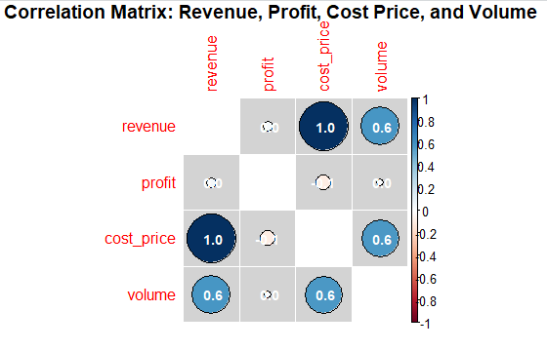


8. Exploratory and Statistical Correlation Analysis with Significance Testing.
Task : To display the correlation matrix and perform statistical correlation analysis with significance testing using the psych package.
Purpose: To identify the strength and direction of relationships between variables while incorporating statistical rigor through significance testing and confidence intervals for more reliable interpretations.
Correlation Matrix: Revenue, Profit, Cost Price, and Volume
p-values from significance tests of correlations
The correlation results suggest that while increasing sales volume and revenue can lead to positive outcomes, the company must also focus on controlling costs, optimizing profit margins, and addressing inefficiencies in pricing and operational expenses.
Olumide Balogun +234-8065060691
17

Slide 19
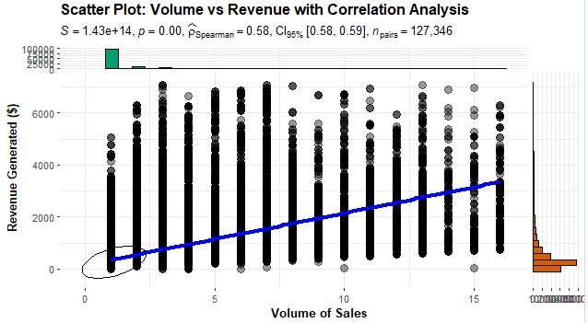
9. The Impact of Volume on Revenue.
Task / Question : How Does Volume Directly Impact Revenue Growth?
Purpose: Is to explore the relationship between Volume and revenue, aiming to identify key revenue drivers, optimize pricing and sales strategies, improve forecasting accuracy, analyze segment contributions, and support data-driven decision-making to maximize revenue generation.
Hypothesis: The p-value of zero indicates a strong correlation between revenue and sales volume, meaning that as sales volume increases, revenue rises significantly.
Insights:
The correlation between revenue and volume is 0.585, indicating a moderate positive relationship. This suggests that as sales volume increases, revenue tends to rise as well, implying that higher sales quantities are associated with higher revenue. This insight highlights the importance for the company to focus on scaling their sales volume in order to drive revenue growth.
Business Implication: To drive revenue growth, the company should focus on increasing sales volume through strategies like selling more units, enhancing marketing, or expanding the customer base.
Olumide Balogun +234-8065060691
18

Slide 20
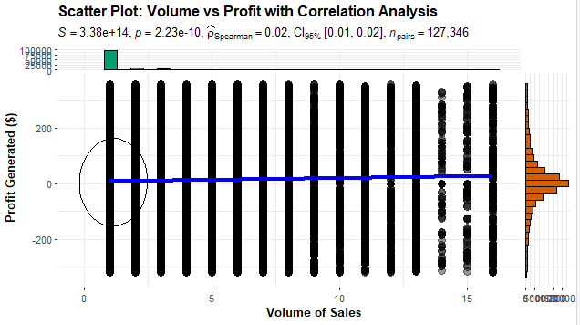
10. The Impact of Volume on Profitability.
Task / Question : How Does Volume Drive Profitability?
Purpose: Is to examine the correlation between the volume of products sold and the profit generated. This analysis aims to uncover key drivers of profitability, enhance business strategies, and support informed decision-making.
Hypothesis: The p-value of 1.28e-21 indicates a strong correlation between profit and sales volume, suggesting that higher sales volumes lead to higher profits, assuming stable profit margins.
Insights:
The correlation between profit and volume is 0.027, which is very close to zero, indicating a negligible relationship between the two variables. This suggests that increasing sales volume alone may not lead to higher profits. Factors such as low profit margins, high operational expenses, or price discounts could be limiting the profitability despite higher sales volumes.
Business Implication: To boost profitability, the company should focus on increasing sales volume while ensuring cost efficiency in production and delivery.
Olumide Balogun +234-8065060691
19

Slide 21
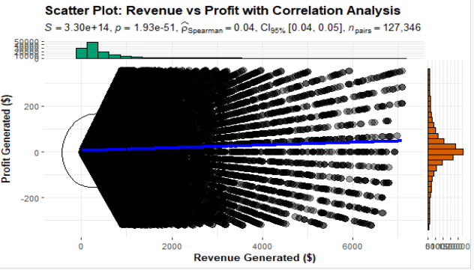
11. Revenue and Profitability: Analyzing the Correlation.
Task / Question : How Does Revenue Influence Profitability?
Purpose: Is to explore the relationship between revenue and profitability, helping to identify profit drivers, optimize business strategies, enhance financial efficiency, and support data-driven decision-making for prioritizing profitable revenue streams.
Hypothesis: The extremely small p-value indicates a strong correlation between revenue and profit, meaning that as revenue increases, profit tends to increase as well.
Insights:
The weak correlation (0.042) between revenue and profit suggests that they are not strongly related. Factors such as high operational expenses, low profit margins, or inefficient cost management may be limiting profitability, despite increases in revenue.
Business Implication: Growing revenue directly boosts profitability. Therefore, strategies to increase sales, raise prices, or expand the customer base should be prioritized to drive profit growth.
Olumide Balogun +234-8065060691
20

Slide 22
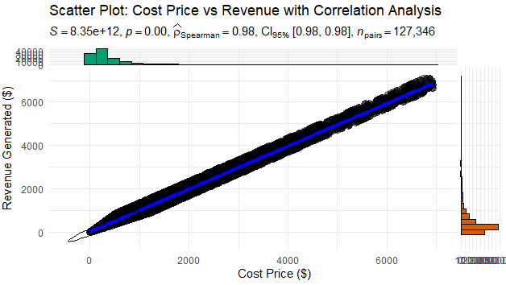
12. The Impact of Cost Price on Revenue.
Task / Question : How Does Cost Price Influence Revenue Streams?
Purpose: Is to understand how the cost of production or acquiring a product impacts revenue generation. This analysis helps identify cost-related revenue drivers, optimize pricing strategies, improve forecasting, enhance business efficiency by addressing cost inefficiencies, and support data-driven decisions for better pricing and revenue optimization.
Hypothesis: The p-value of zero indicates a strong positive relationship between revenue and cost price, where higher costs reduce profitability unless revenue increases proportionally.
Insights:
The strong positive correlation (0.990) between revenue and cost price suggests that higher-cost items drive more revenue. However, this could also point to inefficiency, as high costs may squeeze profit margins unless pricing is managed effectively.
Business Implication: Managing costs is crucial to protect profit margins. The company should control production and acquisition costs to prevent rising costs from offsetting revenue gains, potentially through strategies like optimizing supply chains or negotiating better supplier deals.
Olumide Balogun +234-8065060691
21

Slide 23
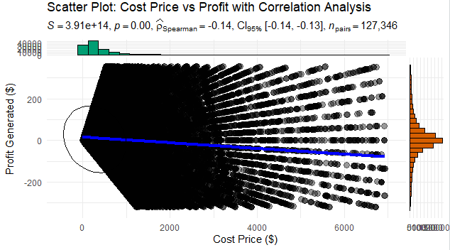
13. The Impact of Cost Price on Profitability.
Task / Question : What Role Does Cost Price Play in Driving Profitability?
Purpose: Is to investigate how the cost of producing or acquiring a product impacts the overall profitability of a business. This analysis ultimately supports strategic decision-making to ensure that businesses optimize costs and maximize profitability.
Hypothesis: The extremely low p-value indicates a significant negative correlation between profit and cost price, suggesting that higher costs reduce profits, especially if revenue doesn't increase proportionally.
Insights:
The correlation between profit and cost price is -0.098, indicating a weak negative relationship. This suggests that as cost price increases, profit tends to slightly decrease. This trend may indicate that rising costs are eroding profit margins, highlighting the need for better cost management and optimized pricing strategies to sustain profitability.
Business Implication: Effective cost management is crucial for maintaining profitability. The company should control costs and optimize operations to prevent high-cost structures from eroding profit margins, while also focusing on revenue growth.
Olumide Balogun +234-8065060691
22

Slide 24
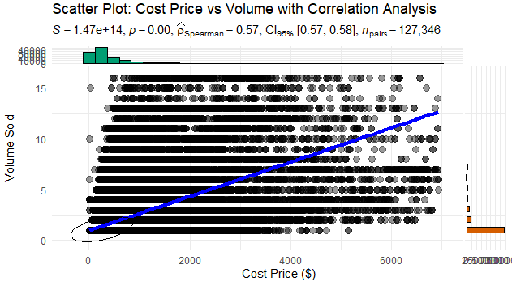
14. The Impact of Cost Price on Volume.
Task / Question : What Role Does Cost Price Play in Driving Volume Sold?
Purpose: Is to evaluate the relationship between cost price and sales volume, identify pricing sensitivity, and uncover insights that can guide pricing strategies, optimize production costs, and predict how variations in cost price impact customer demand and sales performance.
Hypothesis: The zero p-value highlights a strong correlation between sales volume and cost price, with cost per unit potentially decreasing due to economies of scale or increasing due to inefficiencies in the production process.
Insights:
The correlation between volume and cost price is 0.579, indicating a moderate positive relationship. This suggests that higher product volumes are associated with higher cost prices, potentially due to factors such as bulk purchasing expenses or increased costs in production processes. Understanding this relationship is essential for the company to optimize production costs and align sales strategies effectively.
Business Implication: Leveraging economies of scale can lower unit costs and enhance profitability as sales volume grows.
Olumide Balogun +234-8065060691
23

Slide 25
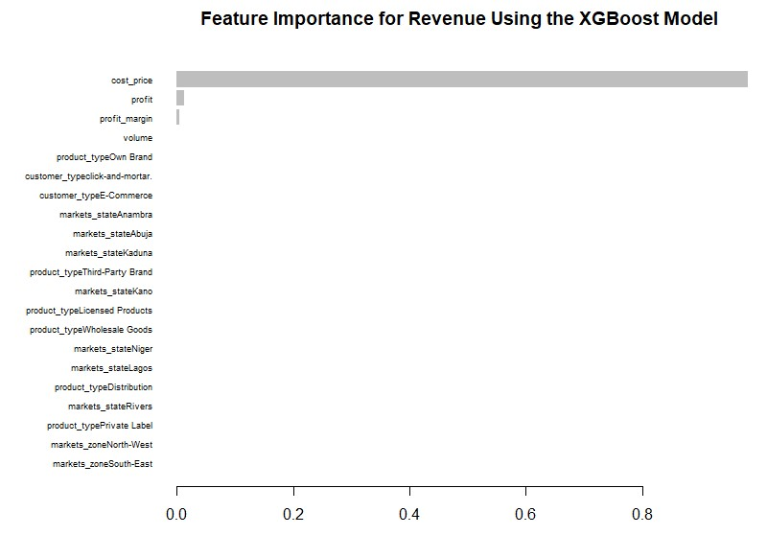
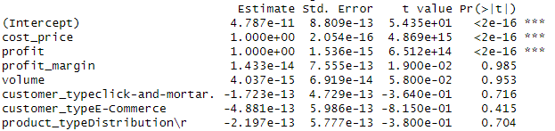
15. Identifying Key Drivers of Revenue Performance: Insights from Feature Importance & Regression Analysis.
Task / Question : What Key Drivers Contribute to Revenue Performance?
Purpose: Is to identify the factors that significantly impact revenue outcomes, enabling businesses to optimize strategies and make informed decisions to enhance sales effectiveness.
Insights:
Significant Variables: Cost Price and Profit have coefficients of 1.000, showing perfect positive relationships with the dependent variable. Both are highly significant (p<0.001p<0.001) with extremely low errors and high t-values, making them the primary drivers in the model.
Non-Significant Variables: Variables like profit margin, volume, and categorical variables (e.g., customer types, product types, market locations) are not statistically significant (p>0.05p>0.05) and have minimal influence on the dependent variable.
Variables Significantly Influencing Revenue Using a Regression Model.
Olumide Balogun +234-8065060691
24

Slide 26
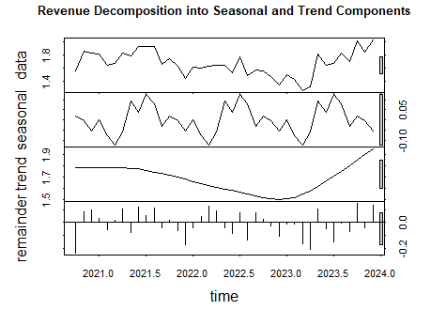
16. Revenue Seasonality and Trend Analysis: Using Decomposition.
Task / Question : What are the seasonal patterns and long-term trends in revenue over time?
Purpose: To uncover recurring seasonal patterns and identify long-term growth or decline trends in revenue, enabling better forecasting, resource allocation, and strategic decision-making for sustained business performance.
1st graph
Insights:
Trend: The second graph highlights the overall long-term direction of revenue. There’s a clear dip around 2022, followed by a gradual recovery and a strong upward trend in 2023. This indicates that business strategies or market conditions improved post-2022, leading to revenue growth.
Seasonality: The third graph shows repeating patterns in revenue, likely driven by recurring events (e.g., holiday seasons, industry-specific cycles). Peaks and troughs may represent periods of higher and lower demand, which could inform inventory and resource planning.
Business Actionable Insight: Understanding these components can help the company plan better for peak seasons, improve operational efficiency during off-peak times, and adjust long-term strategies to maintain upward trends.
2nd graph
3rd graph
Olumide Balogun +234-8065060691
25

Slide 27
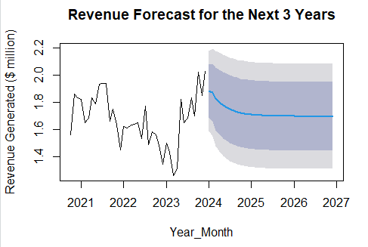
17. The Forecasting Revenue Trends with Time Series Analysis.
Task / Question : What are the predicted revenue trends for the next 36 months, and how can these insights be leveraged to drive favorable business decisions?
Purpose: To leverage these predictions in decision-making that optimizes business strategies, such as pricing, marketing, and resource allocation, to achieve positive financial outcomes.
Insights:
The black line shows historical revenue data, while the blue line represents the predicted trend. There is a gradual flattening in future revenue after an initial increase.
The shaded regions (confidence intervals) indicate uncertainty in predictions. The darker area shows a higher confidence range, while the lighter areas account for wider potential variability.
From 2024 onwards, revenue is expected to stabilize, suggesting steady but limited growth opportunities unless new interventions are introduced.
Business Actionable Insight: To achieve higher growth, the company should diversify offerings, target new customer segments, and explore untapped markets. Additionally, regularly monitor actual revenue against forecasts to refine strategies and ensure accuracy.
Olumide Balogun +234-8065060691
26

Slide 28
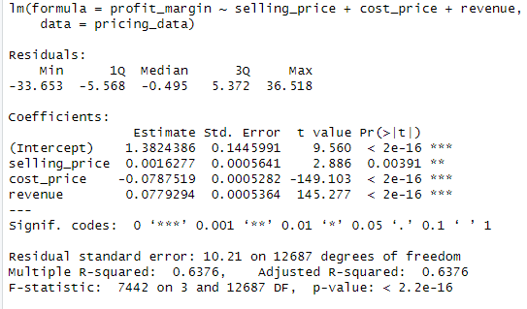
18. Pricing Analysis
Task / Question : What insights can be derived from analyzing the relationships between selling price, cost price, and profit margin using statistical models?
Purpose: Is to uncover how selling price and cost price influence profit margins, optimize pricing strategies, support data-driven decisions, identify segment-specific patterns, forecast financial outcomes, and detect inefficiencies to improve profitability and guide strategic planning.
Regression model analyzing the effect of selling price, cost price, and revenue on profit margin.
Insights:
Selling Price: A unit increase has a small positive impact (+0.0016) on the profit margin.
Action: Incrementally adjust prices to enhance profitability while ensuring customer demand remains steady.
Cost Price: A unit increase has a significant negative impact (-0.0787) on the profit margin.
Action: Prioritize cost management and optimization strategies to minimize profit erosion.
Revenue: A unit increase has a substantial positive impact (+0.0779) on the profit margin.
Action: Focus on driving revenue growth through increased sales, improved marketing strategies, and expanding the customer base to enhance overall business performance.
Olumide Balogun +234-8065060691
27

Slide 29
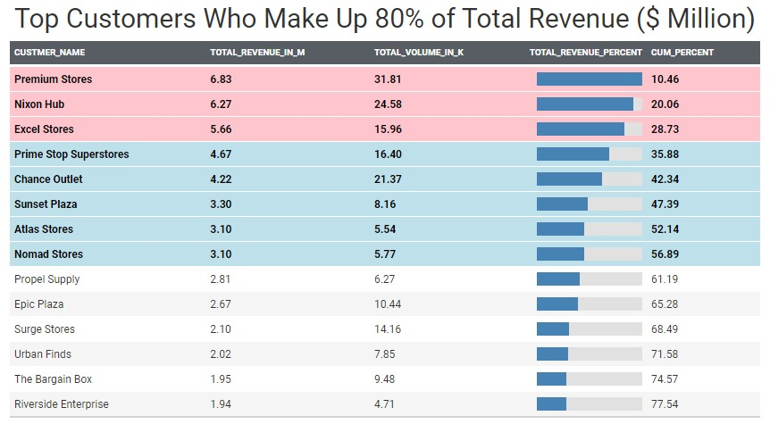
19. Top Customers Who Make Up 80% of Total Revenue.
Task / Question : Which customers contribute to the majority (80%) of the business's total revenue?
Purpose: To identify key customers who contribute significantly to total revenue, enabling businesses to prioritize engagement, optimize marketing, allocate resources efficiently, and make data-driven decisions to retain and grow these high-value customers, ultimately maximizing revenue and fostering long-term success.
Insights:
Starting with the highest revenue contributors and summing their contributions, the top fourteen (14) customers out of thirty-eight (38) account for approximately 80% of the total revenue.
Business Actionable Insight: These fourteen customers are the primary revenue drivers for the business. Focusing on these key customers through targeted customer relationship management, personalized marketing strategies, and optimized service delivery can enhance loyalty and foster further revenue growth.
Customers outside this top 80% may represent lower-priority opportunities for growth or could benefit from alternative strategies aimed at increasing their contributions, such as promotions, upselling, or outreach campaigns to boost engagement and spending.
Olumide Balogun +234-8065060691
28

Slide 30
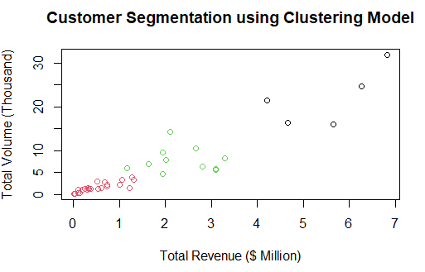
20. The Clustering and Customer Segmentation.
Task / Question : Which customer segments, based on clustering, contribute the most to overall revenue and sales volume?
Purpose: To identify customer segments generating the highest revenue and sales volume, uncovering trends to guide strategic decisions. Insights help optimize resources, target marketing, and tailor engagement strategies for profitability and growth.
Insights:
Three distinct clusters are visible:
1st Cluster (red points): These are customers with low-volume and low-revenue, they are likely occasional buyers or low-spending customers.
2nd Cluster (green points): These are customers with moderate-volume and moderate-revenue customers, they represent a middle tier of customers with more frequent purchases and moderate spending.
3rd Cluster (black points): These are customers with high-volume and high-revenue customers, they are the most valuable customers, contributing most of the revenue and representing high loyalty. This cluster contributes the most to overall revenue and sales volume in the customer segmentation.
Premium Stores leads as the top customer, generating $6.83M in total revenue with a sales volume of 31.8K units. Nixon Hub ranks second, contributing $6.27M in revenue and 24.6K units in volume. Excel Stores secures third place with $5.66M in revenue and 16.0K units in volume. Prime Stop Superstore follows in fourth place with $4.67M in revenue and 16.4K units, while Chance Outlet ranks fifth, delivering $4.22M in revenue and a total volume of 21.4K units.
Olumide Balogun +234-8065060691
29

Slide 31
Final Recommendations
1. Driving Sustainable Growth Through Strategic Optimization and Market Expansion - From 2020 to 2023, the business experienced fluctuating performance: startup growth, a surge in 2021, decline in 2022, and recovery in 2023.
Business Action Plan:
Focus on Revenue Drivers: Identify and prioritize top-performing products and customers using Pareto Analysis.
Enhance Cost Efficiency: Identify cost-saving opportunities through Cost-Benefit Analysis and optimize supplier contracts.
Build a Resilient Supply Chain: Diversify suppliers to reduce risks and use inventory tools to balance stock levels.
Strengthen Market Reach: Target under served segments and invest in digital marketing to expand awareness and sales
Business Strategies:
Enhance market position by optimizing targeting strategies and delivering compelling value propositions, enhance customer retention with loyalty programs, mitigate risks through contingency plans and diversification, and expand marketing strategies using customer feedback.
Expected Impact:
Revenue Growth: 15-20% annually.
Profitability: 10-12% margin improvement.
Customer Retention: 20% increase in repeat business.
Market Share: 5-8% rise in targeted markets
Olumide Balogun +234-8065060691
30

Slide 32
2. Building Stability and Driving Sustainable Growth - The performance from 2022 to 2023 shows a decline in 2022 and recovery in 2023, but with inconsistent trends. While growth was evident in Q4 of 2023, there’s a need for a strategy that ensures long-term stability and growth.
Business Action Plan:
Review and resolve causes of the 2022 decline, strengthen the strategies that drove the 2023 recovery, Reduce Volatility, and Launch loyalty programs and diversify products to create stable revenue.
Business Strategies:
Monitor Performance, optimize Marketing & Pricing, enhance supply chain management and inventory alignment, and explore new markets and customer segments through innovation.
Expected Impact:
Revenue Growth: 15–20% increase in revenue.
Profit Margin Improvement: 10–12% improvement in profitability.
Operational Efficiency: 15–20% improvement in operational efficiency.
Risk Mitigation: 25–30% reduction in volatility.
Customer Retention and Acquisition: 20–25% improvement in customer retention and a 10–15% increase in new customer acquisition.
Olumide Balogun +234-8065060691
31

Slide 33
3. Optimizing Market Zones for Balanced Growth and Increased Profitability - Revenue and profitability across market zones reveals clear disparities in performance. The North-Central zone is the top performer, with strong revenue and profit, while the North-East and South-South zones show significant underperformance
Business Action Plan:
Expand in high-performing zones, address underperforming ones, allocate resources strategically to maximize ROI, and regularly monitor profitability to drive sustainable growth and reduce costs.
Business Strategies:
Create tailored marketing campaigns, optimize pricing and distribution, and strengthen local partnerships in underperforming zones to boost visibility, customer loyalty, and market penetration.
Expected Impact:
Revenue Growth: 10–15% increase in overall revenue.
Profit Margin Improvement: 5–8% increase by optimizing resource allocation.
Operational Efficiency: 10–12% improvement by streamlining supply chains
Customer Engagement: 20–25% boost in underperforming zones
4. Optimizing Product Types for Balanced Growth and Increased Profitability – The analysis shows that "Own Brand" generates the most revenue but has lower profit margins, while "Wholesale Goods" is more profitable despite lower sales. This highlights the need for tailored strategies to optimize performance across product types.
Business Action Plan:
Focus on High-Profit Products ("Wholesale Goods") , strengthen "Own Brand" by boosting sales through promotions and expanded distribution, optimize "Third-Party Brand" by adjusting pricing or supplier terms to improve profitability, and reevaluate Inventory.
Olumide Balogun +234-8065060691
32

Slide 34
Business Strategies:
Tailor campaigns for each product type, conduct price analysis to maximize sales and margins, and expand distribution by exploring new channels for "Own Brand" products.
Expected Impact:
Profit Margin: 5–7% increase by optimizing high-margin products.
Revenue Growth: 8–12% increase for "Own Brand" with enhanced marketing.
Profitability: 3–5% improvement for "Third-Party Brand" through better pricing.
Cost Efficiency: 10–15% reduction in inventory costs.
Market Share: 5–10% increase through targeted campaigns.
5. Optimizing Sales Strategies by Customer Type for Balanced Growth and Enhanced Profitability – The analysis reveals that "Brick and Mortar" leads in revenue and profit, while "E-Commerce" has higher profit margins but lower sales, indicating the need for tailored strategies to optimize growth and profitability for each segment.
Business Action Plan:
Leverage Brick and Mortar Success, Boost E-Commerce Performance, and focus resources on "Brick and Mortar" while improving "E-Commerce" performance.
Business Strategies:
Craft separate marketing strategies for each segment to address their unique preferences and behaviors, and implement loyalty programs for both in-store and online customers to foster repeat business
Expected Impact:
Profit Margin: 3–5% increase by optimizing high-margin products.
Revenue Growth: 8–12% increase in total revenue.
Customer Engagement: 15–20% improvement via enhanced loyalty programs and personalized marketing.
Market Share: 5–7% increase through targeted campaigns.
Olumide Balogun +234-8065060691
33

Slide 35
6. Driving Revenue and Profitability Through Cost Management and Volume Optimization – Based on the correlation analysis, the most significant relationships observed are between revenue and cost price (0.99) and revenue and volume (0.58), indicating that both cost and sales volume play critical roles in driving revenue.
Business Action Plan:
Focus on Revenue Optimization, profit Optimization, and Leverage the strong correlation between revenue and volume to prioritize sales and marketing strategies that increase product volume.
Business Strategies:
Optimize procurement to reduce costs, drive sales through targeted marketing and customer segmentation, and improve profitability by refining pricing, addressing inefficiencies, and introducing higher-margin products.
Expected Impact:
Revenue Growth: 8-12% increase through optimized volume and cost price.
Profit Margin: 3-5% improvement via better cost management and targeted pricing.
Volume Expansion: 10-15% increase from improved availability and marketing.
Cost Efficiency: 10-12% reduction in cost of goods sold through optimized procurement.
Profitability: 3-5% improvement from operational efficiencies and pricing strategies.
Olumide Balogun +234-8065060691
34

Slide 36
7. Driving Revenue Growth and Profitability through Strategic Pricing, High-Margin Products, and Market-Focused Initiatives – The XGBoost model identified cost price and profit margin as key drivers of revenue, emphasizing the need to optimize pricing, margins, and market-specific strategies to improve revenue outcomes..
Business Action Plan:
Scale high-margin product lines, optimize pricing and production costs, implement market-specific strategies for Abuja and South-East, and tailor offerings and marketing to engage top-performing customers and boost sales.
Business Strategies:
Optimize costs, refine pricing, target high-potential regions with tailored campaigns, and expand market reach while enhancing supply chain efficiency to drive profitability and sustainable growth.
Expected Impact:
Revenue Growth: 12–18% increase from optimized pricing and tailored strategies
Profit Margins: 6–9% steady improvement through customer loyalty and operational excellence.
Profitability: 10–15% margin improvement due to cost reductions and high-margin products.
Cost Efficiency: 10–15% savings from improved supply chain efficiency.
8. Strategic Interventions to Reverse Decline and Drive Sustainable Growth by 2026 - Revenue forecasts indicate a gradual decline in 2024, stabilizing in 2025 and 2026. To counter diminishing returns and ensure sustained growth, targeted adjustments in pricing, marketing, and resource allocation are essential.
Business Action Plan:
2024: Boost immediate revenue through seasonal campaigns and optimized pricing for price-sensitive products.
2025: Stabilize by reducing costs via supplier renegotiations and focusing on high-margin and promising product categories.
2026: Achieve sustained growth by expanding into new markets, targeting underserved segments, and innovating high-margin product offerings.
Olumide Balogun +234-8065060691
35

Slide 37
Business Strategies:
Boost sales through targeted marketing and Pareto analysis, enhance cost efficiency with operational audits and predictive analytics, and drive customer retention and brand equity with loyalty programs and innovative campaigns.
Expected Impact:
Revenue Growth: Revenue Growth: 8–12% improvement in 2024 via pricing and promotions; 5–7% annual growth from 2025 through market expansion and innovation.
Cost Efficiency: 10–15% reduction in cost of goods sold by 2025 through supplier renegotiations and resource optimization.
Profit Margins: 6–9% improvement over 36 months through a focus on high-margin products and cost controls.
Customer Retention: 15–20% increase in repeat business via loyalty programs and personalized marketing.
Market Share: 5–8% gain in targeted regions with tailored market-entry strategies
9. Maximizing Revenue and Profitability by Prioritizing Top-Performing Customers for Sustainable Growth – "Premium Stores," "Nixon Hub," and "Excel Stores" contributing significantly to the total revenue (28.77% collectively) , presenting an opportunity to prioritize engagement, streamline marketing, and optimize resource allocation for long-term success.
Business Action Plan:
Focus on prioritizing high-value customers, developing tailored loyalty programs, expanding partnerships with top performers, and gathering customer feedback to enhance relationships, increase sales, and improve offerings.
Business Strategies:
Focus on customer retention through superior service and rewards, upselling and cross-selling high-margin products, targeted marketing to top revenue segments, and volume-based strategies to encourage bulk purchases and drive sales growth.
Olumide Balogun +234-8065060691
36

Slide 38
Expected Impact:
Revenue Growth: 15–20% increase by focusing efforts on top-performing customers.
Profitability: Anticipated 8–12% improvement from targeting high-margin products and upselling strategies.
Customer Retention: Achieve a 20–30% increase in repeat business through personalized incentives and loyalty programs.
Marketing Efficiency: Reduce marketing costs by 10–15% by reallocating efforts toward top customers while still maintaining customer diversity.
Customer Satisfaction: Improve satisfaction rates by 20% through customized solutions and continuous feedback integration.
10. Maximizing Revenue and Profitability through Targeted Customer Segmentation and Strategic Engagement – The customer segmentation analysis reveals that high-volume, high-revenue customers like Premium Stores, Nixon Hub, and Excel Stores are the most valuable, driving most of the revenue and sales volume, presenting key opportunities to optimize engagement and resource allocation for sustained growth and profitability.
Business Action Plan:
Focus on High-Value Customers (3rd Cluster): Prioritize engagement with high-volume, high-revenue customers like Premium Stores, Nixon Hub, and Excel Stores through exclusive programs and premium services to strengthen relationships.
Foster Growth in Moderate-Value Customers (2nd Cluster): Develop tailored marketing campaigns and tiered incentives to encourage increased purchases and loyalty from moderate-volume customers, aiming to transition them into the high-value cluster.
Optimize Resources for Low-Value Customers (1st Cluster): Utilize cost-effective strategies such as automated communication and general promotions to sustain engagement without over-investing resources.
Business Strategies:
Implement exclusive loyalty programs for high-value customers, create personalized marketing campaigns for each cluster, optimize inventory and supply chain for top customers, and nurture moderate and low-value customers through upselling, cross-selling, and education.
Olumide Balogun +234-8065060691
37

Slide 39
Expected Impact:
Revenue Growth: Achieve a 15–20% revenue increase by prioritizing the 3rd cluster and driving growth in the 2nd cluster.
Profit Margins: Enhance margins by 8–12% through targeted resource allocation and cost efficiencies.
Customer Retention: Boost retention rates by 25–30% for high-value customers with loyalty programs and personalized strategies..
Sales Volume: Boost overall sales volume by 10–15% through tailored marketing and engagement strategies.
Operational Efficiency: Reduce costs by 10–15% through better prioritization and streamlined supply chain processes
Implementation Plan
Immediate Actions (0-6 Months):
Focus on revenue drivers by analyzing top products and high-value customers, launching loyalty programs, improving cost efficiency through cost-benefit analysis and supplier renegotiation, boosting sales with targeted campaigns and optimized pricing, and strengthening supply chain resilience by diversifying suppliers and managing inventory effectively.
Short-Term Actions (6-18 Months):
Expand market reach by targeting underperforming regions and reallocating resources to high-performing zones, optimize product offerings by scaling high-margin lines and promoting "Own Brand," boost operational efficiency through audits and predictive analytics, and drive digital and e-commerce growth with enhanced marketing and personalized strategies.
Long-Term Actions (18+ Months):
Sustain growth through innovation by developing high-margin products and customer-centric solutions, expand geographically with market entry strategies and partnerships, ensure consistent profitability with targeted loyalty programs and pricing reassessments, and monitor performance to refine strategies based on feedback and trends.
Olumide Balogun +234-8065060691
38

Slide 40
Conclusion
These final recommendations offer actionable insights to drive sustainable growth and profitability. By addressing key challenges and leveraging opportunities, the company is projected to achieve a revenue increase of over 15%, profit margin growth of more than 8%, a 25% boost in customer retention, and a 10% rise in sales volume by 2024. A strategic focus on enhancing product offerings, expanding regional presence, and strengthening customer engagement will ensure long-term success and greater market competitiveness.
By aligning resources and strategies with critical business drivers, and adopting data-driven decision-making alongside agile marketing approaches, the company is well-positioned to adapt to evolving market demands, achieve higher revenue and profitability, and secure a stronger market presence.
Olumide Balogun +234-8065060691
39

Slide 41
BALOGUN OLUMIDE CHRIS CONTACTS
Tel: +234(0)8065060691
Email: krisbalo11@gmail.com
Github - https://github.com/olumidebalogun1
LinkedIn -https://www.linkedin.com/in/olumide-balogun1/
Medium - https://medium.com/@Olumide-Balogun
X - https://x.com/IAmOluBalogun
Olumide Balogun +234-8065060691

